Slide 1
H1B Application Result Determinants Analysis
IST 707 Project Presentation
Minyang Wang

Slide 2
LCA
Office of Foreign Labor Certification
H1B Visa Lottery
Notes:
Labor Condition Application

Slide 3
Project Summary
Goals:
1. Analyze the determinants of an approved or denied H1B Visa application.
2. Predict the case status of an application submitted by the employer to hire non-immigrant workers under the H-1B visa program.
Data source: Disclosure data of 2017 on U.S Department of Labor website.
Analysis strategies:
1. Use descriptive analysis and association rules to find factors which affect the application result.
2. Use the factors to predict the case status and calculate the prediction accuracy to measure the effectiveness of these factors on the application.

Slide 4
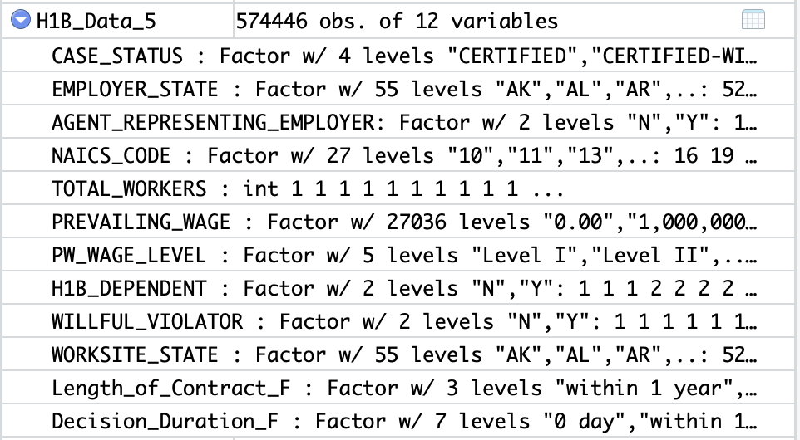
Data Cleaning

Slide 5
Attribute Label | Description
CASE_STATUS | Denied or certified, over all denied rate = 1.3%
EMPLOYER_STATE | State where the employer locates
AGENT_REPRESENTING_EMPLOYER | Whether the employer is represented by an Agent or Attorney
SOC_NAME | Occupational name associated with the job being requested
NAICS_CODE | Industry code associated with the employer
PREVAILING_WAGE | Prevailing Wage for the job being requested
PW_WAGE_LEVEL | Variables include "I", "II", "III", "IV" or "N/A."
H-1B_DEPENDENT | Whether the employer is H1-B dependent or not
WILLFUL_VIOLATOR | Whether the employer has been previously found to be a willful violator or not
WORKSITE_STATE | State of the foreign worker's intended area of employment
CONTRACT_LENGTH | The length of contract that the foreign worker has signed with the employer
DECISION_DURATION | Duration of time that the employee received the case status since it submitted the application

Slide 6
Descriptive analysis – Exploratory analysis
Approved cases: 566977
Denied cases: 7470

Slide 7
Descriptive analysis – Exploratory analysis

Slide 8
Descriptive analysis – Exploratory analysis

Slide 9
Descriptive analysis – Exploratory analysis

Slide 10
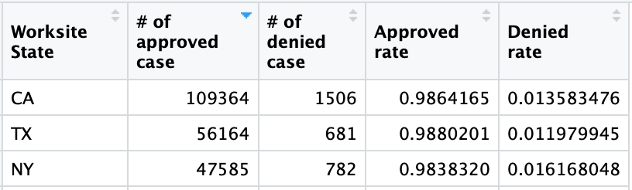
Descriptive analysis – Location (Most applicants)
Notes:
CA-California
TX-Texas
NY

Slide 11
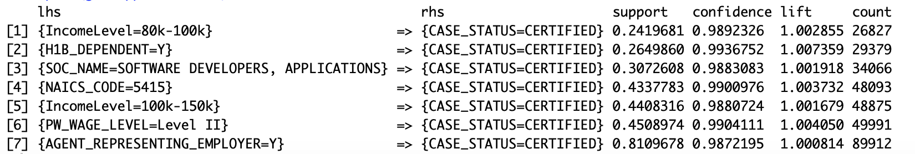
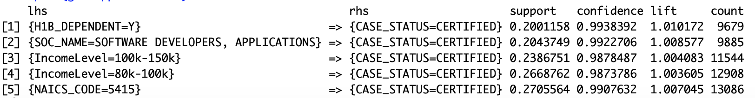
Association rules – Location(CA, NY)
NAICS code | Description
5415 | Computer Systems Design and Related Services

Slide 12
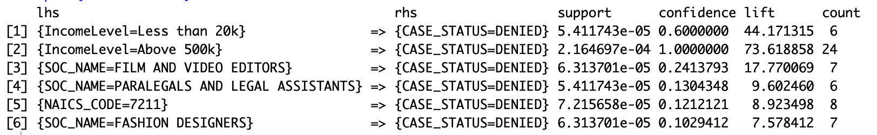
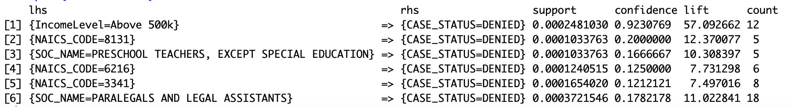
Association rules – Location(CA)
NAICS code | Description
7211 | Traveler Accommodation
8131 | Religious Organizations
6216 | Home Health Care Services
3341 | Computer and Peripheral Equipment Manufacturing

Slide 13
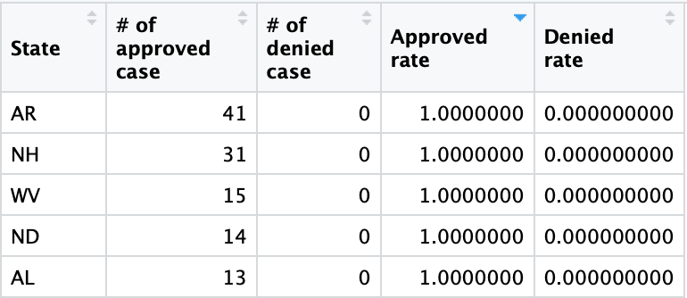
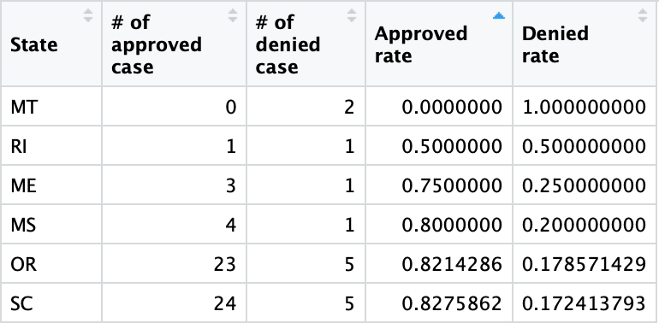
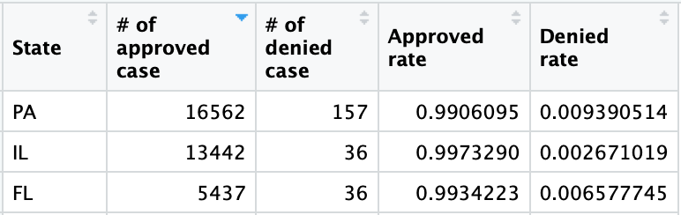
Descriptive analysis – Industry (Management, Scientific, and Technical Consulting Services)
Notes:
AR-Arkansas/NH-New Hampshire/WV-West Virginia/ND-North Dakota/AL-Alabama
PA –Pennsylvania/ IL-Illinois/ Fl- Florida
MT- Montana/ RI- Rhode Island/ ME- Maine/ MS-Mississippi/ OR- Oregon/ SC- South Carolina

Slide 14
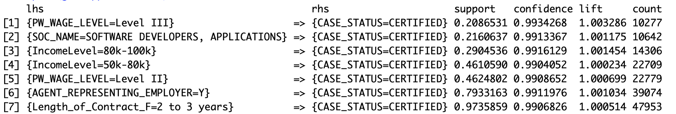
Association rules – Industry (Management, Scientific, and Technical Consulting Services)

Slide 15
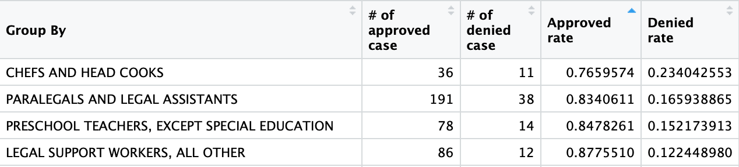
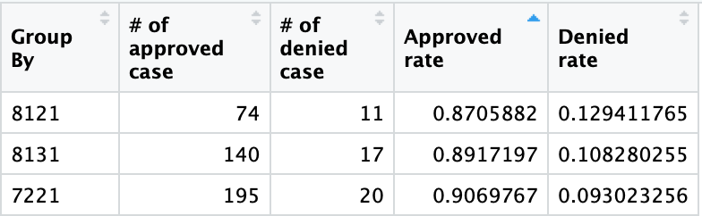
Descriptive analysis – occupational name & industry
NAICS code | Description
8121 | Personal Care Services
8131 | Religious Organizations
7221 | Food Services and Drinking Places

Slide 16
Classification
Attributes:
Whether the employer is represented by an agent or attorney
Employee’s occupational name
Industry code associated with the employer requesting permanent labor condition
Prevailing wage level
Whether the employer is H-1B Dependent
The length of employee’s labor contract
The employee’s annual salary

Slide 17
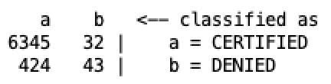
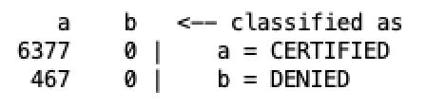
Classification
Results:
Overall accuracy: 98.3%. Baseline: 98.7%
Focus on industries with approved rate lower than 95%
 | 5-fold CV | Hold-out (1:2)
Baseline | 93.2% | 91.5%
Naïve Bayes | 92.3% | 92.7%
SVMs (C=10) | 93.1% | 93.5%
Knn (K=25) | 93.4% | 93.5%
Decision tree | 93.2% | 91.5%
Random forest | 92.2% | 92.5%

Slide 18
Conclusions
CA, TX and NY have the most number of LCAs.
PA, IL and FL are good places for data science major graduates to work in, besides CA and NY.
According to the results of association rules, the employee’s annual salary, job tittle, employer’s industry, whether the employer is H-1B dependent are important determinants of the case status.
Classification models can’t well predict the result of LCA.
Relatively SVMs and Knn algorithm perform better in predicting the case status
Notes:
Even if your major is not related to the popular industries and job, try to find job which relates more to those industries with high approved rate

